Slide 1
Capstone Project
Airbnb Booking Analysis
By- Md Asgar Alam

Slide 2
Content
Team information
Problem statement
Objective
Data summary
Analysis based on:
Neighborhood group
Price
Room types
Number of reviews
Longitude and latitude
Conclusion

Slide 3
Problem statement –
Airbnb Bookings Analysis:
EDA - Exploratory data analysis (EDA) is used to analyze and investigate data sets and summarize their main characteristics, often employing data visualization methods.(Wikipedia)
Since 2008, guests and hosts have used Airbnb to expand on travelling possibilities and present a more unique, personalized way of experiencing the world.

Slide 4
Data analysis on millions of listings provided through Airbnb is a crucial
factor for the company.
These millions of listings generate a lot of data - data that can be analyzed and used for security, business decision, guiding marketing initiatives, implementation of innovative additional services and much more.

Slide 5
Objective
Finding the total number of listings available in New York
To find the average price for available room types/neighborhoods
To find the hosts (Who has the most number of listings and who has more
number of reviews for their listings) through out New York
To find how price is affecting the Maximum reviewed places.
To see the price variation for different listings throughout New York

Slide 6
Data summary
The Airbnb data set contains 48895 records with 16 variables.
Important columns :
'name' - These are names of the properties given by specific hosts. Or i can
say, 'name' is a column which has the descriptions provided by the respective
hosts for the reference of their customers.
'host_id' and 'host_name' => Many properties are being offered by many
hosts. This 'host_id' and 'host_name' holds the records of all those hosts.
'neighbourhood_group' and 'neighbourhood' => These columns holds the information about the city and areas of the properties which are offered in here.

Slide 7
'Longitude' and 'Latitude' => As the name suggests it just contains the
longitude and latitude of the property location
'Room_type' => It displays the room_type of the property ( either private
room / entire home / shared room )
'price' => Its an important column which holds the price value of all those
properties.
'number_of_reviews' and 'reviews_per_month' => It clearly tells about the number of reviews and reviews per month for those properties and hosts hospitality.

Slide 8
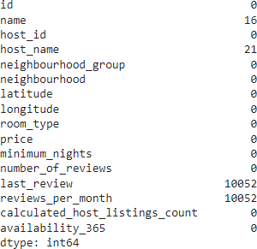
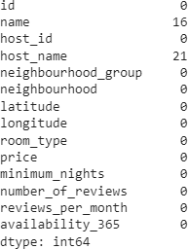
Treating NA
If we have a look at the number of null values throughout the data set, then we can observe that we found some of NA values in few columns.
Last_review column contains 10052 records with null values. This column is not much of a help to analysis. So we drop that column.
We then equated the null values of
‘reviews_per_month’ column as 0.

Slide 9
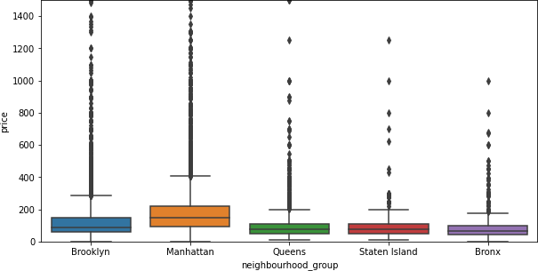
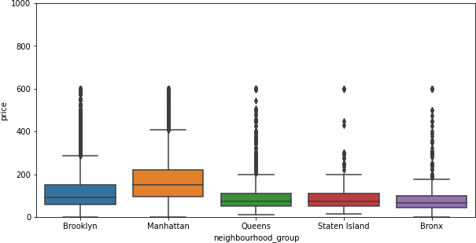
Outliers

Slide 10
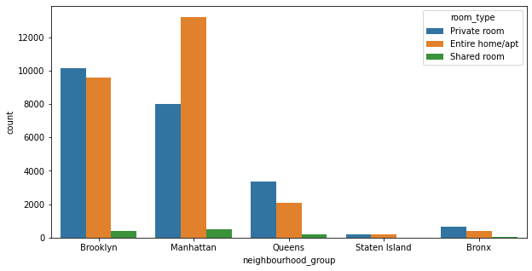
Neighborhood groups
Number of properties available in different neighborhood groups is more in
Manhattan(Home room type)

Slide 11
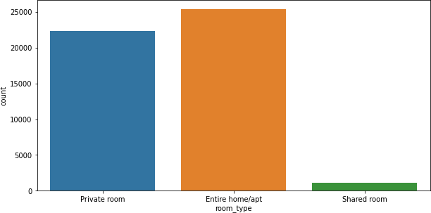
Room type throughout New York
Number of room types available in New York which are of the type Private room,
Entire home/Apartments, Shared room.

Slide 12
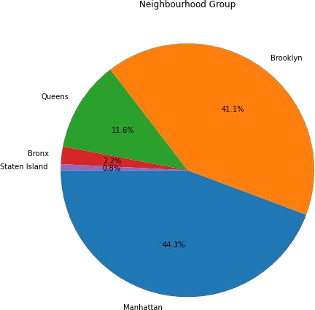
% of listings offered by each neighborhood groups in New York

Slide 13
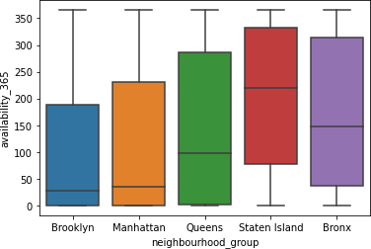
Availability of the listings and neighborhood group

Slide 14
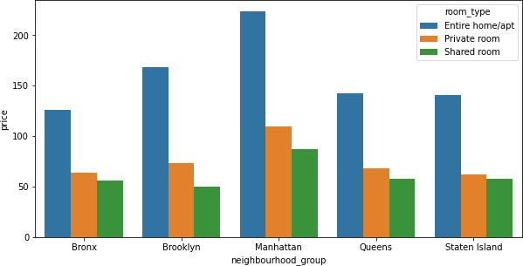
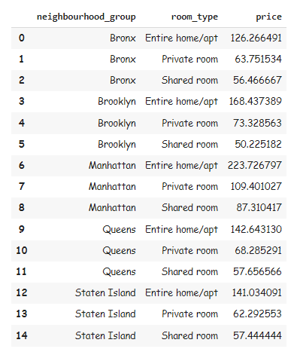
Average price for each room type in neighborhood
If we compare the average price per stay in different neighborhood groups, we
can observe that its high in Manhattan for Entire home/ Apartment.

Slide 15
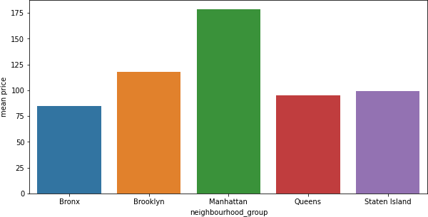
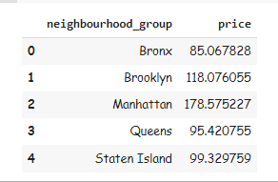
Average price for each neighborhood in NY
Now we are comparing the overall average price per stay throughout New York
for different neighborhood groups. Its clear that its high in Manhattan.

Slide 16
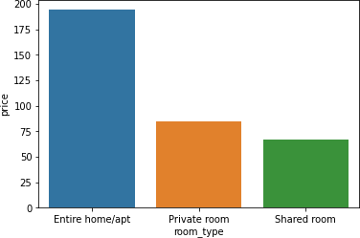
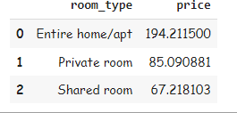
Average price for each room type
By comparing average price through out New York in different available room types, we can observe that, Home/ Apartment is the category which has maximum average price.

Slide 17
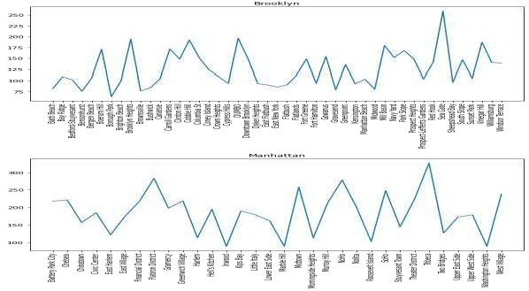
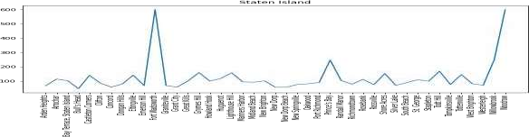
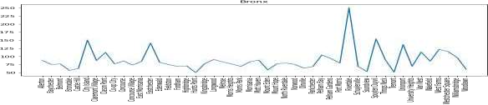
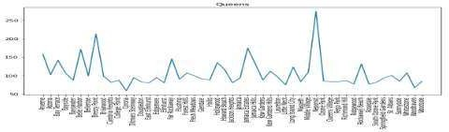
Price variation for each neighborhood group
We can see the price fluctuations through
out different neighborhood groups.
It differs from place to place, heavily in
Manhattan.

Slide 18
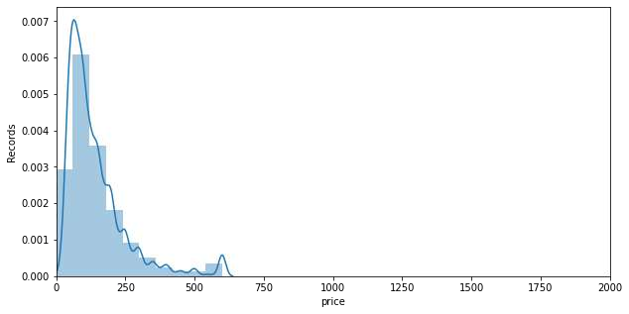
Frequency distribution of prices throughout New York
We can observe that the price range between 0 to 250 is the price which most
listings in New York offers for their places.

Slide 19
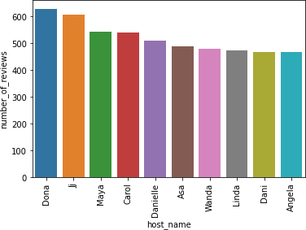
Hosts who got more number of reviews
Dona is the host who got more number of reviews throughout New York.

Slide 20
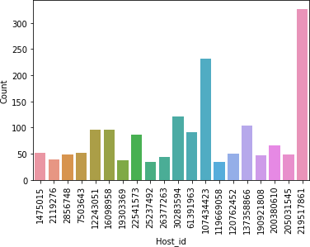

Famous host / host with more properties
We can see the list of hosts
id who possess more number
of properties in New York.
The maximum listings are
offered by host id 219517861
We can see that the host who has more listings in
New York is Sonder and he is from Manhattan.

Slide 21
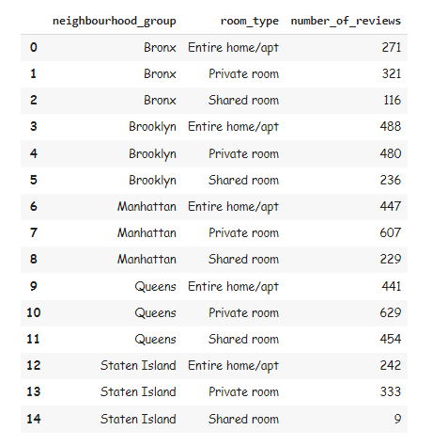
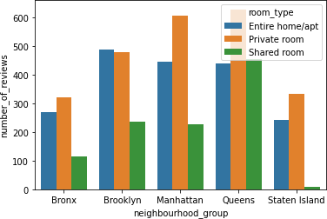
Places where number of reviews were at max
We trying to plot a maximum reviews obtained for listings in particular
neighborhood groups with selected room types.
Queens clearly has the maximum reviews.

Slide 22
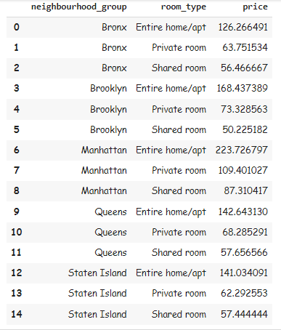
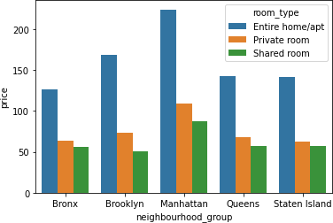
Average price per night
Manhattan has the highest price for a single
night in all room types.

Slide 23
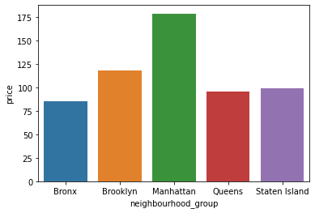
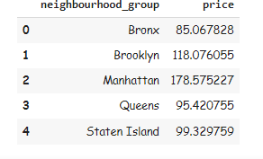
Average price per night in neighborhood groups
We can observe that even if
Consider overall Manhattan listings,
The average price for a night is
High in Manhattan

Slide 24
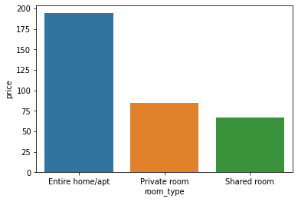
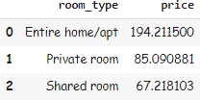
Average price for night in all room types in New York
Entire home/Apartments is type
Which has the highest average
Price for night in all over New York

Slide 25
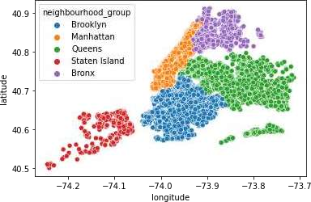
Longitude and latitude
We can see the geo locations of all neighborhood groups throughout
New York.

Slide 26
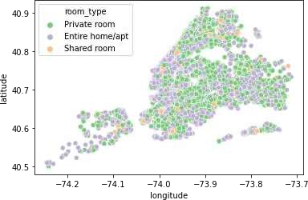
Room types available in respective location
We can see the different room types available throughout New York

Slide 27
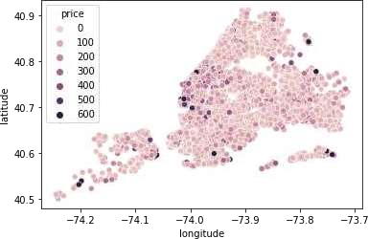
Price variations for different location
We can clearly see the places which is offering listings with maximum price
throughout New York

Slide 28
Conclusion
Price depends on Neighbourhood group. Its high in Manhattan. Manhattan is the city which has a lot of price fluctuations. We can even find the less prices for some listings in particular neighbourhood. We can even find the costliest listings in the same neighbourhood.
We can get the famous host (Sonder from Manhattan) from the number of properties he is offering. He owns many properties throughout Manhattan, New York, which in turn is the busiest city in New York.

Slide 29
We can observe host Dona from Queens has the property with more number of reviews. Queens is the place where there are listings available with reasonable price when compared to New York. We can conclude that people tend to go to the place with reasonable price.
Throughout NY, Entire home/apt is the room type which is mostly in
demand.
Manhattan is the place which is famous and can be a good option for
the companies to invest on properties of Entire home/Apt.
We can increase the number of room type of places whichever got
more number of reviews.

Slide 30
Thank You

